Slide 1
Chapter 6
Digital Design and Computer Architecture: ARM® Edition
Sarah L. Harris and David Money Harris

Slide 2
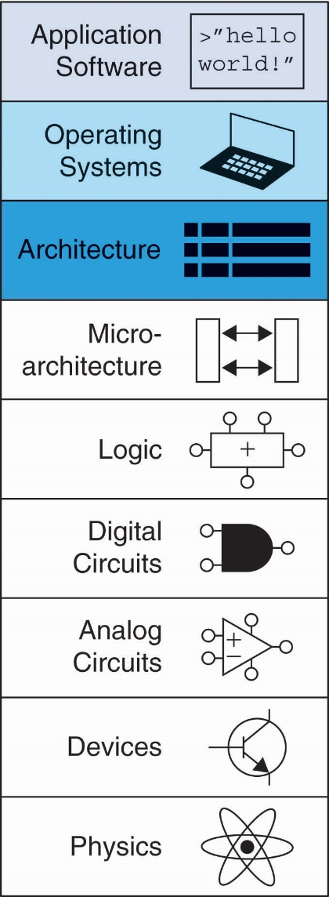
Chapter 6 :: Topics
Introduction
Assembly Language
Machine Language
Programming
Addressing Modes

Slide 3
Main Discussions
ARM instruction set and registers
Branches & procedure calls
Addressing Modes

Slide 4
Introduction
Jumping up a few levels of abstraction
  Architecture: programmer’s view of computer
    Defined by instructions & operand locations
  Microarchitecture: how to implement an architecture in hardware (covered in Chapter 7)

Slide 5
Instructions
Commands in a computer’s language
  Assembly language: human-readable format of instructions
  Machine language: computer-readable format (1’s and 0’s)

Slide 6
ARM Architecture
Developed in the 1980’s by Advanced RISC Machines – now called ARM Holdings
Nearly 10 billion ARM processors sold/year
Almost all cell phones and tablets have multiple ARM processors
Over 75% of humans use products with an ARM processor
Used in servers, cameras, robots, cars, pinball machines, etc.

Slide 7
ARM Architecture
Developed in the 1980’s by Advanced RISC Machines – now called ARM Holdings
Nearly 10 billion ARM processors sold/year
Almost all cell phones and tablets have multiple ARM processors
Over 75% of humans use products with an ARM processor
Used in servers, cameras, robots, cars, pinball machines,, etc.
Once you’ve learned one architecture, it’s easier to learn others

Slide 8
Architecture Design Principles
Underlying design principles, as articulated by Hennessy and Patterson:
    Regularity supports design simplicity
    Make the common case fast
    Smaller is faster
    Good design demands good compromises

Slide 9
Instruction: Addition
ADD: mnemonic – indicates operation to perform
b, c: source operands
a: destination operand
C Code
a = b + c;
ARM Assembly Code
ADD a, b, c

Slide 10
Instruction: Subtraction
Similar to addition - only mnemonic changes
SUB: mnemonic
b, c: source operands
a: destination operand
C Code
a = b - c;
ARM assembly code
SUB a, b, c

Slide 11
Design Principle 1
Regularity supports design simplicity
Consistent instruction format
Same number of operands (two sources and one destination)
Ease of encoding and handling in hardware

Slide 12
Multiple Instructions
More complex code handled by multiple ARM instructions
C Code
a = b + c - d;
ARM assembly code
ADD t, b, c ; t = b + c
SUB a, t, d ; a = t - d

Slide 13
Design Principle 2
Make the common case fast
ARM includes only simple, commonly used instructions
Hardware to decode and execute instructions kept simple, small, and fast
More complex instructions (that are less common) performed using multiple simple instructions

Slide 14
Design Principle 2
Make the common case fast
ARM is a Reduced Instruction Set Computer (RISC), with a small number of simple instructions
Other architectures, such as Intel’s x86, are Complex Instruction Set Computers (CISC)

Slide 15
Operand Location
Physical location in computer
  Registers
  Constants (also called immediates)
  Memory

Slide 16
Operands: Registers
ARM has 16 registers
Registers are faster than memory
Each register is 32 bits
ARM is called a “32-bit architecture” because it operates on 32-bit data

Slide 17
Design Principle 3
Smaller is Faster
ARM includes only a small number of registers

Slide 18
ARM Register Set
Name | Use
R0 | Argument / return value / temporary variable
R1-R3 | Argument / temporary variables
R4-R11 | Saved variables
R12 | Temporary variable
R13 (SP) | Stack Pointer
R14 (LR) | Link Register
R15 (PC) | Program Counter

Slide 19
Operands: Registers
Registers:
  R before number, all capitals
  Example: “R0” or “register zero” or “register R0”

Slide 20
Operands: Registers
Registers used for specific purposes:
  Saved registers: R4-R11 hold variables
  Temporary registers: R0-R3 and R12, hold intermediate values
  Discuss others later

Slide 21
Instructions with Registers
Revisit ADD instruction
C Code
a = b + c;
ARM Assembly Code
; R0 = a, R1 = b, R2 = c
ADD R0, R1, R2

Slide 22
Operands: Constants\Immediates
Many instructions can use constants or immediate operands
For example: ADD and SUB
value is immediately available from instruction
C Code
a = a + 4;
b = a – 12;
ARM Assembly Code
; R0 = a, R1 = b
ADD R0, R0, #4
SUB R1, R0, #12

Slide 23
Generating Constants
Generating small constants using move (MOV):
C Code
//int: 32-bit signed word
int a = 23;
int b = 0x45;
ARM Assembly Code
; R0 = a, R1 = b
MOV R0, #23
MOV R1, #0x45

Slide 24
Generating Constants
Generating small constants using move (MOV):
Constant must have < 8 bits of precision
Note: MOV can also use 2 registers: MOV R7, R9
C Code
//int: 32-bit signed word
int a = 23;
int b = 0x45;
ARM Assembly Code
; R0 = a, R1 = b
MOV R0, #23
MOV R1, #0x45

Slide 25
Generating Constants
Generate larger constants using move (MOV) and or (ORR):
C Code
int a = 0x7EDC8765;
ARM Assembly Code
# R0 = a
MOV R0, #0x7E000000
ORR R0, R0, #0xDC0000
ORR R0, R0, #0x8700
ORR R0, R0, #0x65

Slide 26
Operands: Memory
Too much data to fit in only 16 registers
Store more data in memory
Memory is large, but slow
Commonly used variables still kept in registers

Slide 27
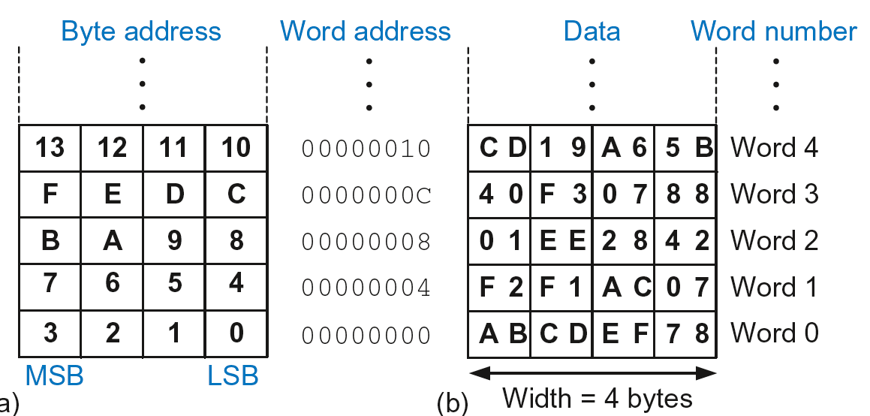
Byte-Addressable Memory
Each data byte has unique address
32-bit word = 4 bytes, so word address increments by 4

Slide 28
Reading Memory
Memory read called load
Mnemonic: load register (LDR)
Format:
LDR R0, [R1, #12]
  Address calculation:
    add base address (R1) to the offset (12)
    address = (R1 + 12)
  Result:
    R0 holds the data at memory address (R1 + 12)
Any register may be used as base address

Slide 29
Reading Memory
Example: Read a word of data at memory address 8 into R3
  Address = (R2 + 8) = 8
  R3 = 0x01EE2842 after load
ARM Assembly Code
MOV R2, #0
LDR R3, [R2, #8]

Slide 30
Writing Memory
Memory write are called stores
Mnemonic: store register (STR)

Slide 31
Writing Memory
Example: Store the value held in R7 into memory word 21.
Memory address = 4 x 21 = 84 = 0x54
ARM assembly code
MOV R5, #0
STR R7, [R5, #0x54]
The offset can be written in decimal or hexadecimal

Slide 32
Recap: Accessing Memory
Address of a memory word must be multiplied by 4
Examples:
  Address of memory word 2 = 2 × 4 = 8
  Address of memory word 10 = 10 × 4 = 40

Slide 33
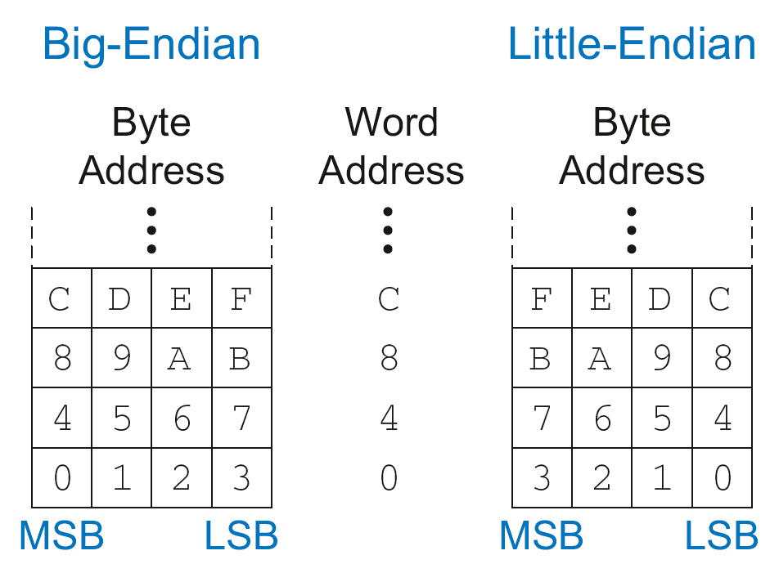
Big-Endian & Little-Endian Memory
How to number bytes within a word?
  Little-endian: byte numbers start at the little (least significant) end
  Big-endian: byte numbers start at the big (most significant) end

Slide 34
Big-Endian & Little-Endian Memory
Jonathan Swift’s Gulliver’s Travels: the Little-Endians broke their eggs on the little end of the egg and the Big-Endians broke their eggs on the big end
It doesn’t really matter which addressing type used – except when two systems share data

Slide 35
Big-Endian & Little-Endian Example
Suppose R2 and R5 hold the values 8 and 0x23456789
After following code runs on big-endian system, what value is in R7?
In a little-endian system?
      STR R5, [R2, #0]
      LDRB R7, [R2, #1]

Slide 36
Big-Endian & Little-Endian Example
Suppose R2 and R5 hold the values 8 and 0x23456789
After following code runs on big-endian system, what value is in R7?
In a little-endian system?
      STR R5, [R2, #0]
      LDRB R7, [R2, #1]
      Big-endian: 0x00000045
      Little-endian: 0x00000067

Slide 37
Programming
High-level languages:
  e.g., C, Java, Python
  Written at higher level of abstraction

Slide 38

Ada Lovelace, 1815-1852
British mathematician
Wrote the first computer program
Her program calculated the Bernoulli numbers on Charles Babbage’s Analytical Engine
She was a child of the poet Lord Byron

